Slide 1
Time Series Forecasting
“Forecasting is not about predicting the future, it’s about reducing uncertainty.” -- Paul Saffo

Slide 2
Introduction to Forecasting Methods

Slide 3
What is Stationarity?
A stationary process has statistical properties that do not change over time
Key characteristics remain constant:
Mean
Variance
No trend or Seasonality
Get the plots of some stationary and Non stationary
Jupyter notebook with sattionarity

Slide 4
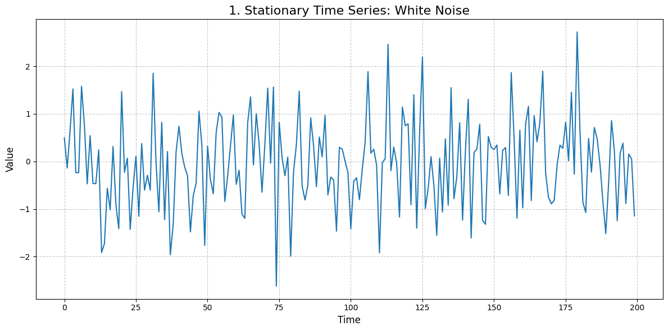
This series is stationary because its statistical properties (mean, variance, and autocorrelation) remain constant over time.
It fluctuates randomly around a constant mean (zero in this case) with a consistent spread (variance).

Slide 5
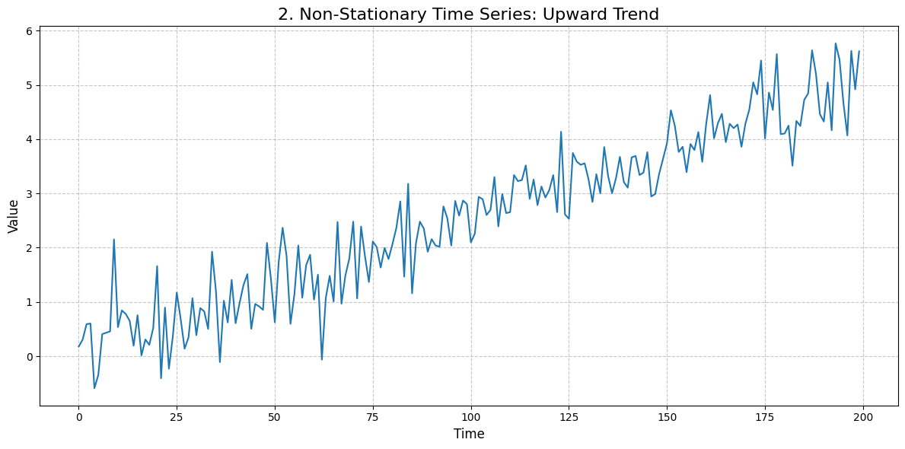
Explanation:
This series is non-stationary because it exhibits a clear upward trend.
its mean is not constant over time; it systematically increases, violating the constant mean assumption of stationarity.

Slide 6
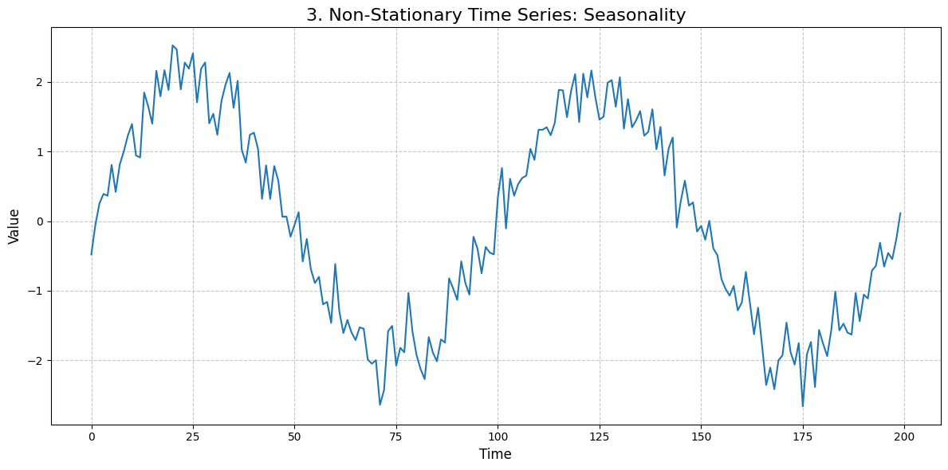
Explanation:
This series is non-stationary due to its pronounced seasonality. The mean of the series varies cyclically over time, following a predictable pattern.
This violates the constant mean assumption.

Slide 7
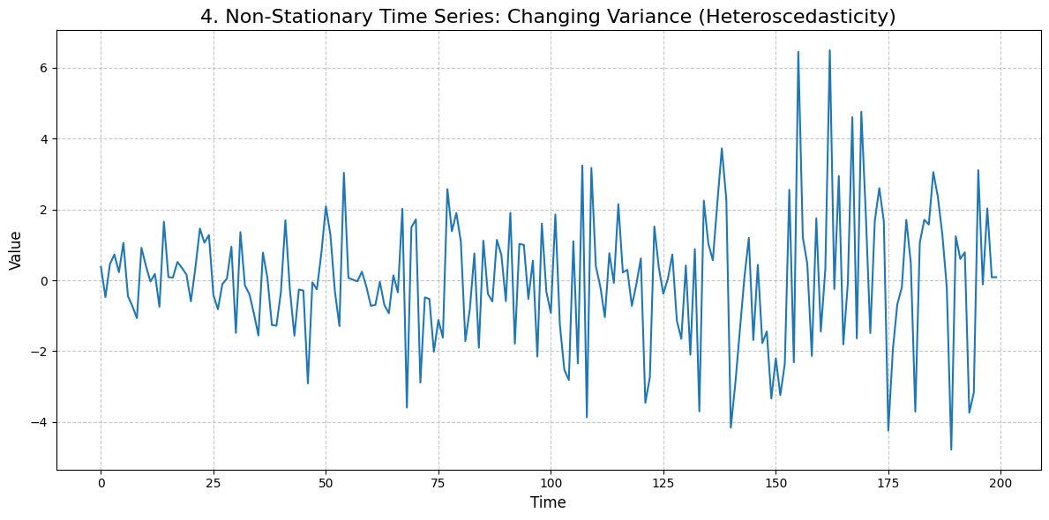
Explanation:
This series is non-stationary because its variance is not constant over time (a condition known as heteroscedasticity).
The fluctuations become larger towards the end, meaning the spread of the data is changing.

Slide 8
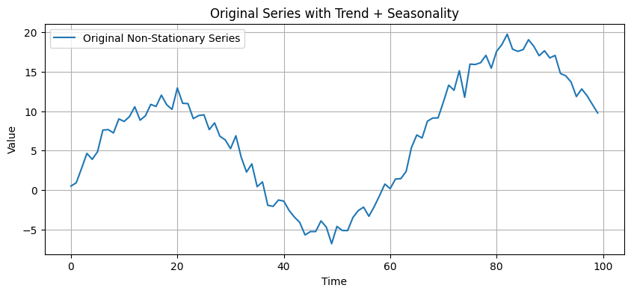

Slide 9
ARMA

Slide 10
ARMA Process
An ARMA(p, q) (Autoregressive Moving Average) model is a fundamental tool in time series analysis.
It is a combination of its past values (autoregressive part) and past forecast errors (moving average part).
The 'p' and 'q' in the notation denote the orders of the AR and MA parts, respectively.

Slide 11
AR(p) Process: Autoregressive
An AR(p) process models the current value of a time series, Y_{t}​, as a linear combination of its p previous values plus a random disturbance term, ϵ_{t}​.
This process assumes that the past has a direct influence on the present.
Formula
Where:
Y_{t}​ is the value of the time series at time t.
c is a constant term.
ϕ₁​,...,ϕ_{p}​ are the model parameters.
ϵ_{t​} is a white noise term, representing an unpredictable shock or innovation at time t.

Slide 12
AR Example
AR(1) example
An AR(1) process is one of the simplest and most common. Its current value depends only on the immediate past value
Y_{t​}=c+ϕ₁​Y_{t−1}​​+ϵ_{t​}
For stationarity, the absolute value of the parameter ϕ1​ must be less than 1 (∣ϕ₁​∣<1).
If ∣ϕ₁​∣≥1, the series will exhibit an explosive trend.
AR(2) Example
An AR(2) process depends on the two previous values.
Y_{t​}=c+ϕ₁​Y_{t−1}​+ϕ₂​Y_{t−2}​+ϵ_{t​}

Slide 13
MA(q) Process: Moving Average
An MA(q) process models the current value of a time series as a linear combination of past white noise or innovation terms.
This process suggests that past shocks or random errors persist and influence the present value.
The general form is:
Y_{t​}=μ+θ₁​ϵ_{t−1​}+θ₂​ϵ_{t−2}​+...+θ_{q​}ϵ_{t−q​}+ϵ_{t​}
Where:
μ is the mean of the series.
θ₁​,...,θ_{q}​ are the model parameters.
ϵ_{t}​,ϵ_{t−1}​,... are the white noise terms.

Slide 14
MA Example
MA(1) Example
An MA(1) process is the simplest MA model. The current value depends on the previous innovation term.
Y_{t}​=μ+θ₁​ϵ_{t−1}​+ϵ_{t​}
MA(2) Example
An MA(2) process depends on the two previous innovation terms.
Y_{t​}=μ+θ₁​ϵ_{t−1}​+θ₂​ϵ_{t−2}​+ϵ_{t​}

Slide 15
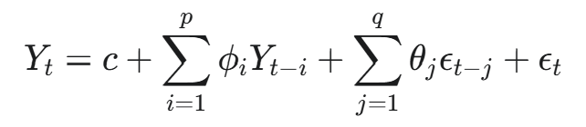
ARMA(p, q) as a Combination
The ARMA(p, q) model combines the autoregressive and moving average parts.
It is used when a time series cannot be adequately described by a pure AR or pure MA model.
The general form is:
Y_{t}​=c+ϕ₁​Y_{t−1}​+...+ϕ_{p​}Y_{t−p​}+θ_{1​}ϵ_{t−1}​+...+θ_{q}​ϵ_{t−q}​+ϵ_{t​}
An ARMA model is a simpler representation of a time series than a high-order AR or MA model alone.

Slide 16
ACF and PACF

Slide 17
Auto Correlation Function(ACF)
The Autocorrelation Function (ACF) measures the correlation between a time series and its lagged values

Slide 18
The Partial Autocorrelation Function (PACF)
The Partial Autocorrelation Function (PACF) measures the correlation between a time series and its lagged values, but it removes the influence of all the intermediate lags
For example, the PACF at lag 3 measures the correlation between Y_{t}​ and Y_{t−3​} after accounting for the effects of Y_{t−1}​ and Y_{t−2}​.
The PACF plot helps identify the direct relationship between a point and its past values.

Slide 19
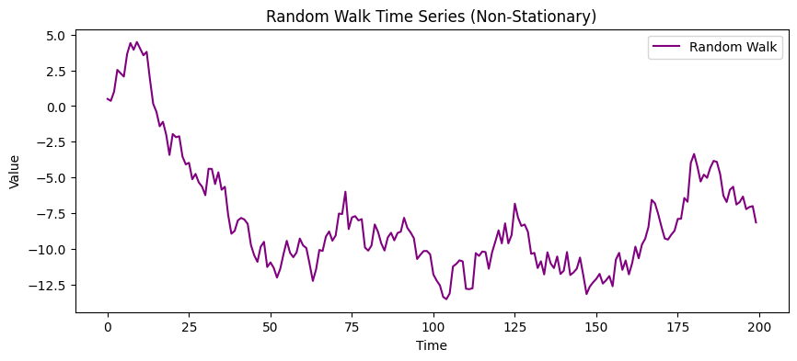
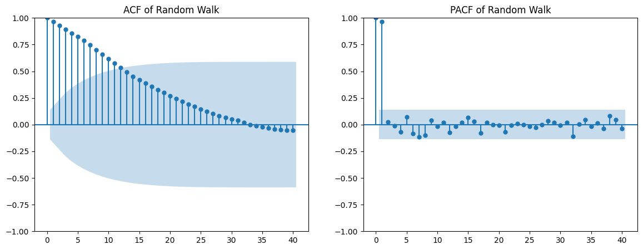
Random walk ACF and PACF

Slide 20
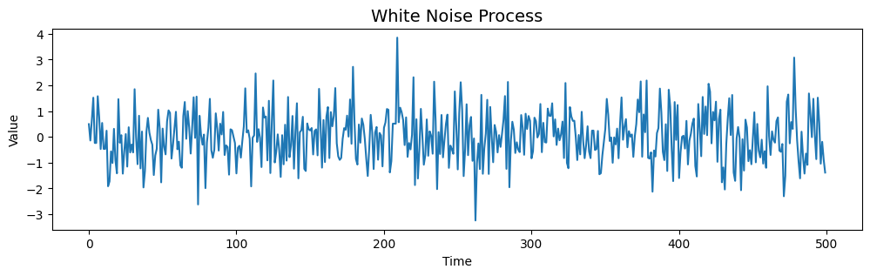
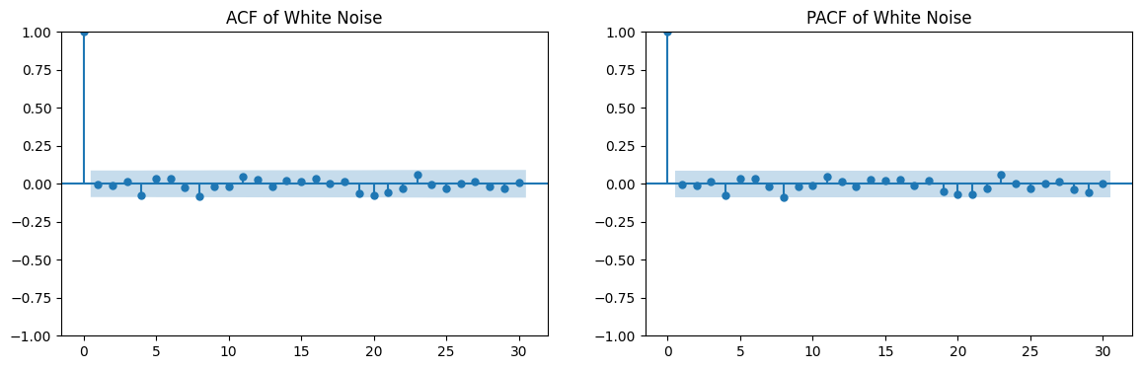
White Noise

Slide 21
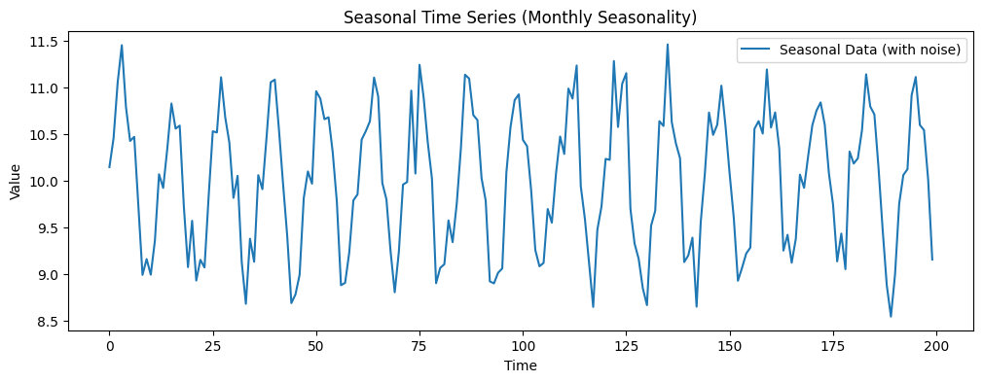
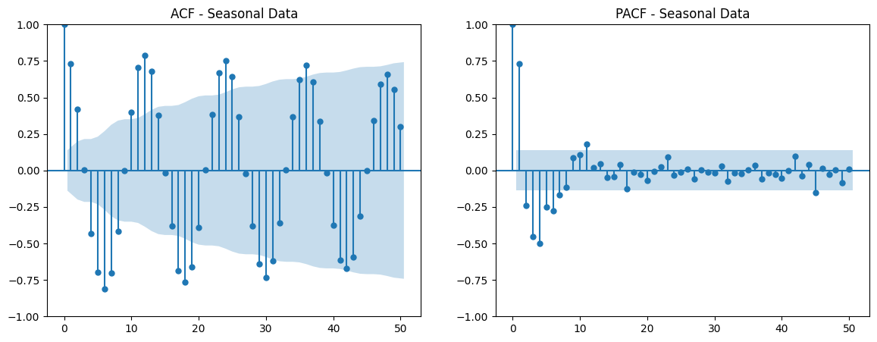
ACF and PACF with Seasonal data
ACF: shows strong spikes at seasonal lags (12, 24, 36, …).
PACF: also shows spikes at seasonal lags, but often decays faster.
Seasonal ARIMA (SARIMA) models are needed when such spikes are seen.

Slide 22
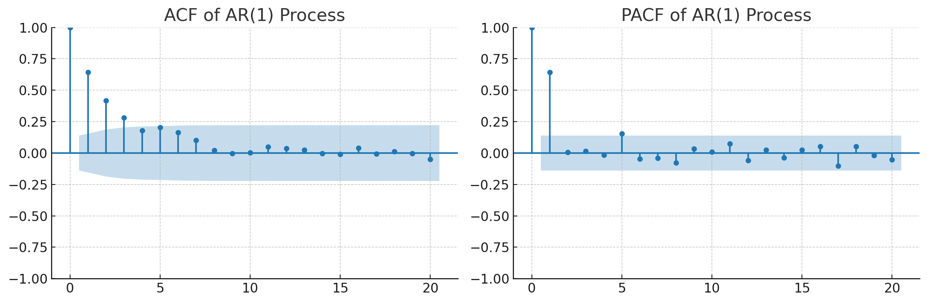
Theoretical ACF/PACF for ARMA Processes
The behavior of the ACF and PACF plots is crucial for identifying the appropriate orders (p and q) for an ARMA model.
AR(1) Process
ACF: Decays exponentially towards zero. The decay can be positive or negative, depending on the sign of the AR parameter (ϕ₁​).
PACF: Has a single significant spike at lag 1 and then drops to zero for all subsequent lags.

Slide 23
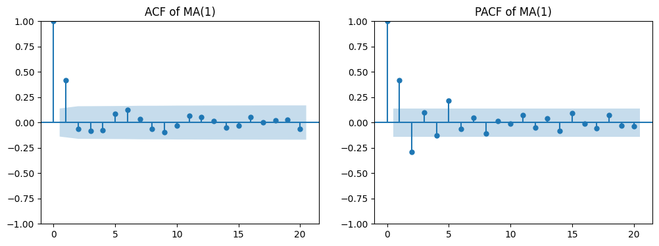
Theoretical ACF/PACF for ARMA Processes
The behavior of the ACF and PACF plots is crucial for identifying the appropriate orders (p and q) for an ARMA model.
MA(1) Process
ACF: Has a single significant spike at lag 1 and then drops to zero for all subsequent lags.
PACF: Decays exponentially towards zero. The decay can be positive or negative, depending on the sign of the MA parameter (θ1​).

Slide 24
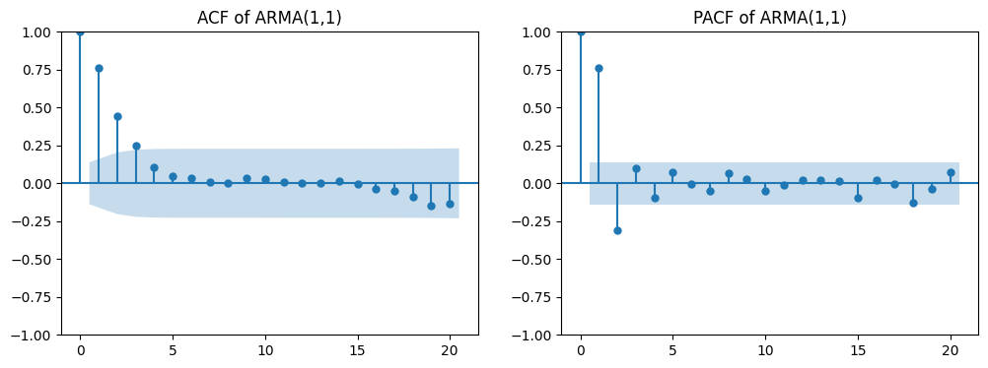
ARMA(1,1) Process
ARMA(1,1) Process
ACF: Decays exponentially towards zero after lag 1. The decay pattern is influenced by both the AR and MA parameters.
PACF: Decays exponentially towards zero after lag 1. The decay pattern is also influenced by both parameters.

Slide 25
Properties of Sample Mean and Correlation
For a stationary ARMA process, the sample mean will converge to the true mean of the process.

Slide 26
Reference links
https://github.com/egorhowell/Youtube/tree/main/Time-Series-Crash-Course

Slide 27


